Slide 1
Movie Recommendation System
Guide: Mr. Milind Kapase

Slide 2






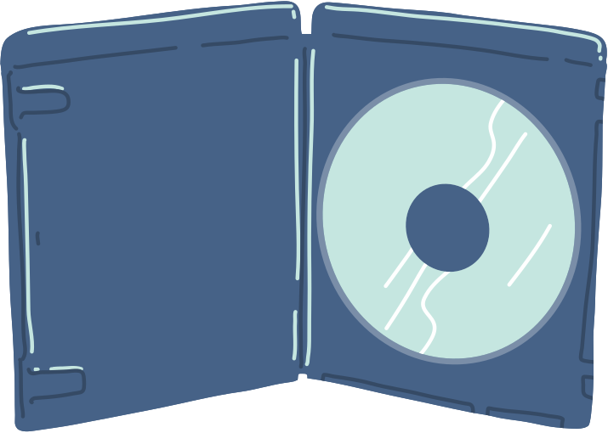
Group Members
Aryan Sharma (240843025009)
Roshan Kature (240843025019)
Mandar Tannu (240843025021)
Sarang Vasugade (240843025035)
Swarupraj Bhosale (240843025045)

Slide 3
What is Recommendation System
A recommendation system suggests relevant items to users based on data analysis.
It helps users discover products, movies, music, etc., tailored to their preferences.
Widely used in platforms like Netflix, Amazon, and YouTube.

Slide 4
How Recommendation System is different from regression and classifiation
Regression: Predicts continuous values (e.g., price prediction).
Classification: Predicts discrete labels (e.g., spam or not spam).
Recommendation System: Predicts user preferences by suggesting items, focusing on similarity or patterns rather than direct labels or values.

Slide 5
Types of Recommendation Systems
Content-Based Filtering:
Recommends items similar to those the user liked in the past.
Based on item features (e.g., genres, descriptions).
Collaborative Filtering:
Based on user behavior and preferences.
Finds similarities between users or items.
Hybrid Systems:
Combines content-based and collaborative filtering for improved performance.

Slide 6
What Movie Recommendation System Predicts
Identifies movies similar to a given movie based on content features.
Uses textual data (genres, plot summaries) to find semantic relationships.
Predicts movies that match user interests without using user-specific data.

Slide 7
Goals
1
Provide accurate movie recommendations using machine learning.
2
Build an end-to-end machine learning application for scalability and efficiency

Slide 8
Technology Stack
Python: For Programming
Pyspark: For Preprocessing
Tableau: For Visualization
Streamlit: For UI

Slide 9
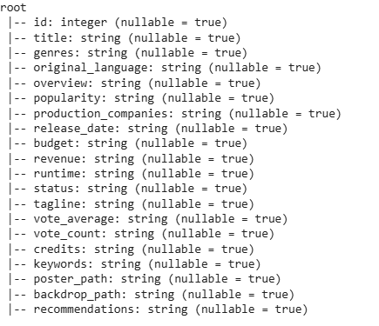
Data
These files contain metadata for more than 722,317 movies listed in the TMDB Dataset.

Slide 10
Data Preprocessing
Handling Missing Values:
Before: 722K records → After Handling: 640K records.
Missing values also handled using ‘fllna’.
Columns with more than 20% missing values were removed directly to maintain data integrity without excessive data loss.
Removing Duplicate Records:
Ensured data uniqueness and eliminated redundancy to improve model performance.

Slide 11
Data Preprocessing
Feature Engineering:
Rating Count & Rating Columns: Added to compute weighted ratings for better relevance in recommendations.
Combining Text Columns
Normalization with Min-Max Scaling:
Applied Min-Max Scaling to numerical features to bring all values within the same range (0 to 1).
Prevents dominance of features with larger scales, ensuring balanced similarity calculations.

Slide 12
Text and Numerical Features
Text Features:
Titles, genres, overview, credits.
Numerical Features:
Movie ratings, release year, runtime.

Slide 13
Text Embedding using SBERT
SBERT (Sentence-BERT):
Converts textual data into high-dimensional numerical vectors (embeddings).
Captures semantic meaning, enabling effective similarity comparison.
Model used: 'all-MiniLM-L6-v2' for efficient performance.

Slide 14
Recommending the movies using KNN
K-Nearest Neighbors (KNN) with Cosine Similarity:
Finds the top-N most similar movies to the input movie.
Measures similarity using cosine similarity between movie embeddings.
Efficient, simple, and effective for content-based recommendations.

Slide 15
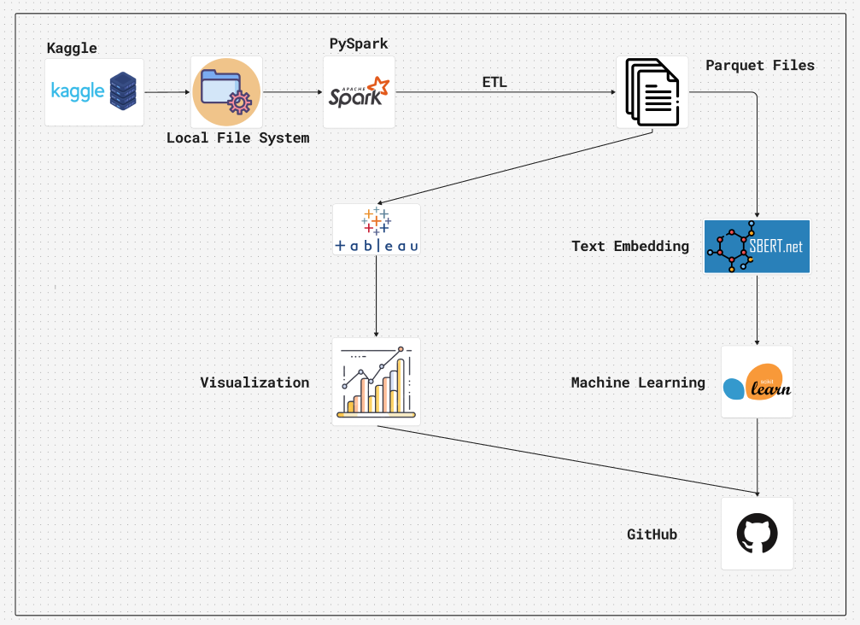
Architecture

Slide 16
Future Scope
Personalized User Profiles
Hybrid Recommendation System
Trending & Popular Movie Section
YouTube Trailer Integration
Watchlist & Bookmark Feature

Slide 17
Conclusion
Optimized big data processing with Apache Spark for scalability.
Built a content-based movie recommendation system using BERT embeddings.
Implemented KNN for fast and accurate similarity search.
Enhanced user experience with a seamless web-based platform.

Slide 18

THANK YOU

